Slide 1
Digital Camera, Pixel, and Image Representation
Lecture 2
Adnan Majeed
Lecturer

Slide 2
Introduction
A digital camera captures and stores images in digital form using electronic sensors instead of film. It converts light into digital data that can be processed, stored, and displayed.

Slide 3
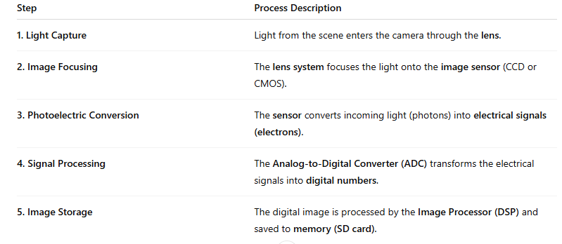
Working Principle of a Digital Camera
A digital camera captures images through the following main steps:

Slide 4


Slide 5
Components Inside a Digital Camera
Component | Function
Lens System | Focuses incoming light rays to form a clear image on the sensor.
Aperture | Controls the amount of light entering the camera (like the pupil of an eye).
Shutter | Determines exposure time — how long the sensor is exposed to light.
Image Sensor (CCD/CMOS) | Converts light into electrical signals.
Analog-to-Digital Converter (ADC) | Converts analog signals from the sensor into digital data.
Digital Signal Processor (DSP) | Enhances image quality (color balance, contrast, noise reduction).
Viewfinder / LCD Screen | Displays the image being captured.
Memory Card | Stores the captured digital images.
Battery | Powers the electronic components.
Flash Unit | Provides artificial light for low-light conditions.

Slide 6
Types of Image Sensors
Type | Full Form | Characteristics
CCD | Charge Coupled Device | High image quality, low noise, more power consumption.
CMOS | Complementary Metal Oxide Semiconductor | Faster, cheaper, low power, slightly more noise.

Slide 7
Concept of Pixel
A Pixel (Picture Element) is the smallest unit of a digital image.
Each pixel represents a single point in the image and holds color and intensity information.
The resolution of an image depends on the number of pixels (e.g., 1920×1080 = 2,073,600 pixels ≈ 2.1 Megapixels).
Types of Pixel Values:
Binary Image: Pixels are either 0 (black) or 1 (white).
Grayscale Image: Pixels range from 0–255, where 0 = black, 255 = white.
Color Image: Each pixel has three components (R, G, B) with values 0–255.

Slide 8
Example (Grayscale Pixel):
Pixel Value | Shade
0 | Black
128 | Gray
255 | White

Slide 9
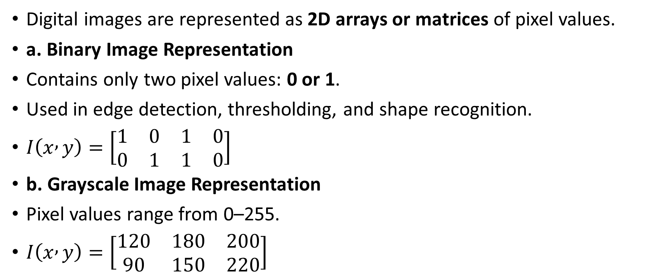
Image Representation in Digital Form
Digital images are represented as 2D arrays or matrices of pixel values.
a. Binary Image Representation
Contains only two pixel values: 0 or 1.
Used in edge detection, thresholding, and shape recognition.
$I\left(x , y\right)=\left[\begin{matrix}1 & 0 & 1 & 0 \\ 0 & 1 & 1 & 0\end{matrix}\right]$
b. Grayscale Image Representation
Pixel values range from 0–255.
$I\left(x , y\right)=\left[\begin{matrix}120 & 180 & 200 \\ 90 & 150 & 220\end{matrix}\right]$

Slide 10
Pixel | R | G | B | Color
(1,1) | 255 | 0 | 0 | Red
(1,2) | 0 | 255 | 0 | Green
(1,3) | 0 | 0 | 255 | Blue

Slide 11
Image Resolution and Quality
Resolution: Number of pixels in width × height.
Higher resolution → more detail.
Image Size (bytes):
Size=Width×Height×Color Depth\

Slide 12
Image Type | Color Depth | Typical Use
Binary | 1-bit | Document scanning
Grayscale | 8-bit | Medical imaging
RGB | 24-bit | Photography, videos

Slide 13
Summary table
Topic | Key Point
Digital Camera | Converts light to digital images via electronic sensors.
Main Components | Lens, Aperture, Shutter, Sensor, ADC, Processor, Memory.
Pixel | Smallest image unit holding color/intensity info.
Image Representation | Binary, Grayscale, and RGB matrix formats.
Resolution | Determines image clarity and detail.

Slide 14
Applications
Photography and Videography
Medical Imaging (X-rays, MRI)
Satellite Imaging and Remote Sensing
Security & Surveillance
Machine Vision and Robotics
Digital Art & Image Processing Algorithms

Slide 15
+----------------------------+
| Lens System |
+-------------+--------------+
|
[Aperture]
|
[Shutter]
|
+-------------+
| Image Sensor|
| (CCD/CMOS) |
+-------------+
|
[ADC + DSP]
|
[Memory Storage]
|
[Display]

